Slide 1
C++ Primer
Chapter 9 – Sequential Containers
Section 2
Unrestricted

Slide 2
Sequential Container Operations Adding Elements to a Sequential Container
Flexible memory management at runtime(Exc array)
Adding an element to a vector/string
Adding an element to deque

Slide 3
push_back
new element at the end of container
Increase the size of container by 1
Copy the element
void pluralize(size_t cnt, string &word)
{
if (cnt > 1)
word.push_back(’s’); // same as word += ’s’
}

Slide 4
push_front
List, forward_list, deque
list<int> ilist;
// add elements to the start of ilist
for (size_t ix = 0; ix != 4; ++ix)
ilist.push_front(ix);

Slide 5
Adding Elements at a Specified Point in the Container
Supported for vector, deque, list, and string
slist.insert(iter, "Hello!"); // insert "Hello!" just before iter
It is legal to insert anywhere in a vector, deque, or string. However, doing so can be an expensive operation

Slide 6
Inserting a Range of Elements
vector<string> v = {"quasi", "simba", "frollo", "scar"};
// insert the last two elements of v at the beginning of slist
slist.insert(slist.begin(), v.end() - 2, v.end());
slist.insert(slist.end(), {"these", "words", "will",
"go", "at", "the", "end"});
// run-time error: iterators denoting the range to copy from
// must not refer to the same container as the one we are changing
slist.insert(slist.begin(), slist.begin(), slist.end());

Slide 7
Using the Return from insert
list<string> lst;
auto iter = lst.begin();
while (cin >> word)
iter = lst.insert(iter, word); // same as calling push_front

Slide 8
Using the Emplace Operations
emplace_front, emplace, emplace_back(C++11)
// construct a Sales_data object at the end of c
// uses the three-argument Sales_data constructor
c.emplace_back("978-0590353403", 25, 15.99);
// error: there is no version of push_back that takes three arguments
c.push_back("978-0590353403", 25, 15.99);
// ok: we create a temporary Sales_data object to pass to push_back
c.push_back(Sales_data("978-0590353403", 25, 15.99));
// iter refers to an element in c, which holds Sales_data elements
c.emplace_back(); // uses the Sales_data default constructor
c.emplace(iter, "999-999999999"); // uses Sales_data(string)
// uses the Sales_data constructor that takes an ISBN, a count, and a price
c.emplace_front("978-0590353403", 25, 15.99);

Slide 9
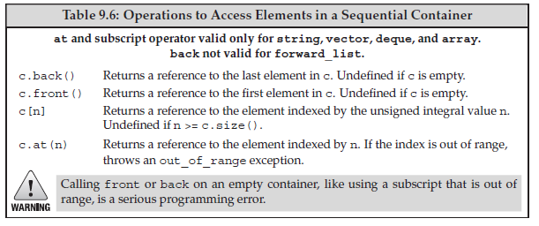
Accessing Elements
front = first element
back = last element

Slide 10
The Access Members Return
Return references
if (!c.empty()) {
c.front() = 42; // assigns 42 to the first element in c
auto &v = c.back(); // get a reference to the last element
v = 1024; // changes the element in c
auto v2 = c.back(); // v2 is not a reference; it’s a copy of c.back()
v2 = 0; // no change to the element in c
}

Slide 11
Subscripting and Safe Random Access
vector<string> svec; // empty vector
cout << svec[0]; // run-time error: there are no elements in svec!
cout << svec.at(0); // throws an out_of_range exception

Slide 12
Erasing Elements
Programmer must check that element is exist!!!
pop_front,
pop_back,
These functions return void. So programmer neet to save the value before pop operation
while (!ilist.empty()) {
process(ilist.front()); // do something with the current top of ilist
ilist.pop_front(); // done; remove the first element
}

Slide 13
Removing an Element from within the Container
Both forms of erase return an iterator referring to the location after the (last) element that was removed
list<int> lst = {0,1,2,3,4,5,6,7,8,9};
auto it = lst.begin();
while (it != lst.end())
if (*it % 2) // if the element is odd
it = lst.erase(it); // erase this element
else
++it;

Slide 14
Removing Multiple Elements
The iterator-pair version of erase lets us delete a range of elements:
// delete the range of elements between two iterators
// returns an iterator to the element just after the last removed element
elem1 = slist.erase(elem1, elem2); // after the call elem1 == elem2
To delete all the elements:
slist.clear(); // delete all the elements within the container
slist.erase(slist.begin(), slist.end()); // equivalent

Slide 15
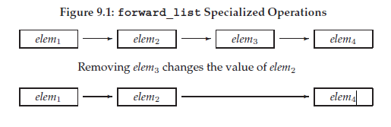
Specialized forward_list Operations
To understand why forward_list has special versions of the operations to add and remove elements, consider what must happen when we remove an element from a singly linked list:

Slide 16
Specialized forward_list Operations(Cont’d)
Prev connection is not exist so:
insert_after,
emplace_after,
erase_after
To erase first element:
before_begin

Slide 17
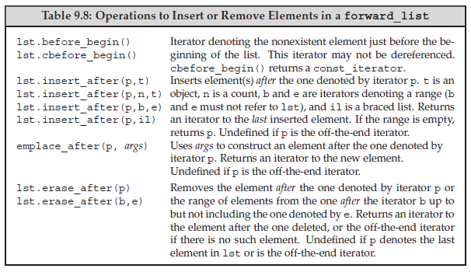
forward_list<int> flst = {0,1,2,3,4,5,6,7,8,9};
auto prev = flst.before_begin(); // denotes element "off the start" of flst
auto curr = flst.begin(); // denotes the first element in flst
while (curr != flst.end()) { // while there are still elements to process
if (*curr % 2) // if the element is odd
curr = flst.erase_after(prev); // erase it and move curr
else {
prev = curr; // move the iterators to denote the next
++curr; // element and one before the next element
}
}

Slide 18
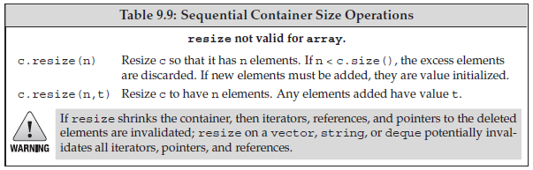
Resizing a Container
list<int> ilist(10, 42); // ten ints: each has value 42
ilist.resize(15); // adds five elements of value 0 to the back of ilist
ilist.resize(25, -1); // adds ten elements of value -1 to the back of ilist
ilist.resize(5); // erases 20 elements from the back of ilist

Slide 19
Container Operations May Invalidate Iterators
ADVICE: MANAGING ITERATORS
When you use an iterator (or a reference or pointer to a container element), it is a good idea to minimize the part of the program during which an iterator must stay valid.
Because code that adds or removes elements to a container can invalidate iterators, you need to ensure that the iterator is repositioned, as appropriate, after each operation that changes the container. This advice is especially important for vector, string, and deque.

Slide 20
Writing Loops That Change a Container
insert(), erase()
// silly loop to remove even-valued elements and insert a duplicate of odd-valued elements
vector<int> vi = {0,1,2,3,4,5,6,7,8,9};
auto iter = vi.begin(); // call begin, not cbegin because we’re changing vi
while (iter != vi.end()) {
if (*iter % 2) {
iter = vi.insert(iter, *iter); // duplicate the current element
iter += 2; // advance past this element and the one inserted before it
} else
iter = vi.erase(iter); // remove even elements
// don’t advance the iterator; iter denotes the element after the one we erased
}

Slide 21
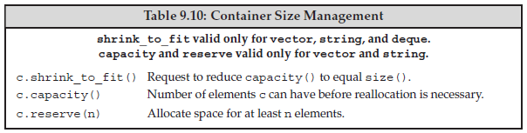
How a vector Grows
reserve()
Shrink_to_fit()(c++11) not have to return a memory, implementation can reduce the call
capacity() and size()

Slide 22
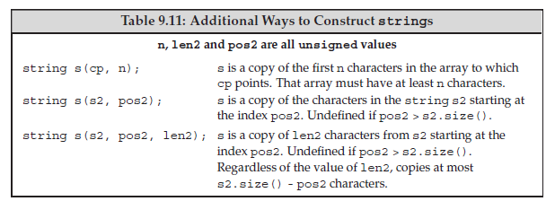
Additional string Operations
OtherWays to Construct strings
const char *cp = "Hello World!!!"; // null-terminated array
char noNull[] = {’H’, ’i’}; // not null terminated
string s1(cp); // copy up to the null in cp; s1 == "Hello World!!!"
string s2(noNull,2); // copy two characters from no_null; s2 == "Hi"
string s3(noNull); // undefined: noNull not null terminated
string s4(cp + 6, 5);// copy 5 characters starting at cp[6]; s4 == "World"
string s5(s1, 6, 5); // copy 5 characters starting at s1[6]; s5 == "World"
string s6(s1, 6); // copy from s1[6] to end of s1; s6 == "World!!!"
string s7(s1,6,20); // ok, copies only to end of s1; s7 == "World!!!"
string s8(s1, 16); // throws an out_of_range exception

Slide 23
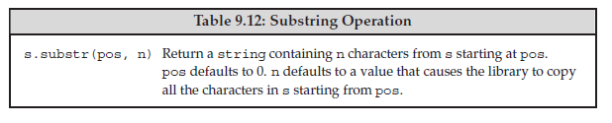
The substr Operation
string s("hello world");
string s2 = s.substr(0, 5); // s2 = hello
string s3 = s.substr(6); // s3 = world
string s4 = s.substr(6, 11); // s3 = world
string s5 = s.substr(12); // throws an out_of_range exception

Slide 24
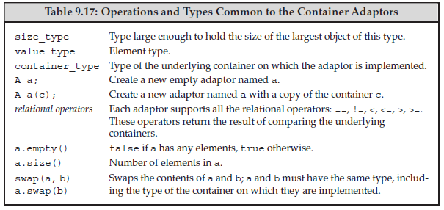
Container Adaptors
stack
queue
priority_queue

Slide 25
Defining an Adaptor
deq is a deque<int>;
stack<int> stk(deq); // copies elements from deq into stk
By default; stack and queue is deque, priority_queue is vector
// empty stack implemented on top of vector
stack<string, vector<string>> str_stk;
// str_stk2 is implemented on top of vector and initially holds a copy of svec
stack<string, vector<string>> str_stk2(svec);

Slide 26
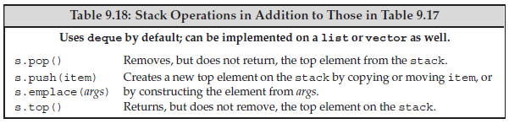
Stack Adaptor
stack<int> intStack; // empty stack
// fill up the stack
for (size_t ix = 0; ix != 10; ++ix)
intStack.push(ix); // intStack holds 0 . . . 9 inclusive
while (!intStack.empty()) { // while there are still values in intStack
int value = intStack.top();
// code that uses value
intStack.pop(); // pop the top element, and repeat
}

Slide 27
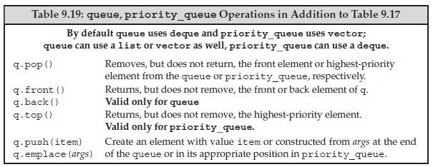
The Queue Adaptors
queue(FIFO)
Priority_queue(priority)

